Slide 1

Making Sense of
C nspiracy Theories
ilan moscovitz
metis sf18_ds11

Slide 2
CON·SPIR·A·CY THE·O·RY:
a theory that explains an event or set of circumstances as a result of a secret plot by usually powerful conspirators
- Merriam Webster
- Merriam Webster
Notes:
Dictionary definition: explanation based on secret plot by powerful conspirators

Slide 3
CONSPIRACIST WORLDVIEW:
Nothing happens by accident
Nothing is as it seems
Everything is connected
- Michael Barkun
Notes:
The sense I’m looking at are Key to understanding conspiracist worldview:
-Nothing happens by accident
-Nothing is as it seems
-Everything is connected

Slide 4
Psychologically Enticing
Affects behavior (vaccines)
Entering Mainstream (birther
- Merriam Webster
WHY THEY MATTER:
Enticing
Influential
Mainstreaming
Notes:
Psychologically enticing: Create explanations out of chaos
Influential: Vaccines, politics
Conspiracist thinking is becoming more mainstream, especially in politics.
My favorite, flat earth theory, is up to 2% of the population,

Slide 5

The Flat-Earth:
Dimensional Reduction Hidden in Plain Sight

Slide 6
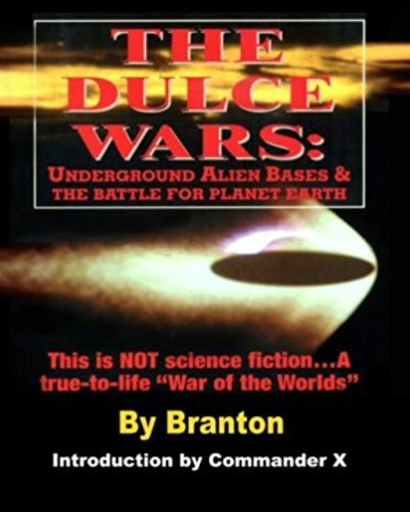
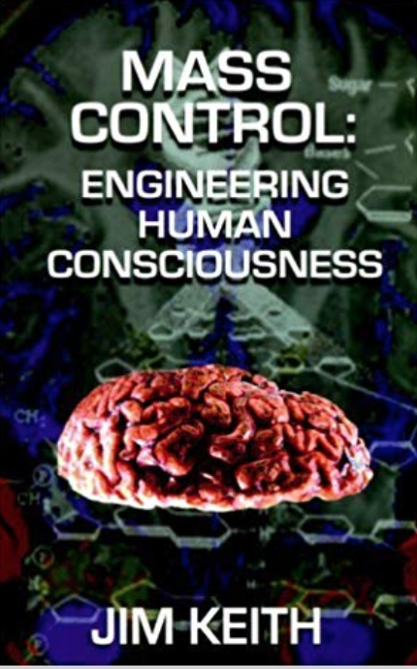
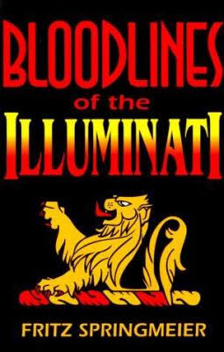
Corpus: 176 influential books and articles
Notes:
Quickly
Goal: Discover what are the different kinds of conspiracy theories. Constructed a bibliography of the most influential works according to academics and wikipedia
Scoured the internet for texts/pdfs and I used LDA topic modeling.
We’ll see some of the challenges that come up later
Settled on 176

Slide 7
Challenges:
Nonintuitive connectedness
Nonintuitive number of topics
Nonintuitive topic assessment
Notes:
Conspiracy theories present several challenges -- it’s difficult to know how interconnected they’ll be and how many different types, and figuring
Out whether topics are good or not requires a lot of brushing up on exotic knowledge.

Slide 8
Illuminati
occult theocrasy
plantard
prieure sion
irinn
plantard
Is there an Illuminati plan for a powerful new United Nations agency, the World Food Authority, which will control the production and distribution of food?
Texe Marrs, Days of Hunger, Days of Chaos
Notes:
2 good ones and one bad one

Slide 9
Aliens/Ancient Societies
astarte
secret powers
atlan
chaldee
inter-
stellar
“...It would be unlikely that any such advanced civilization would find any resources on Earth that could not be found in numerous other star systems closer to their civilization…. Perhaps an advanced martial extraterrestrial civilization might use Earth as a type of training ground for their warriors.”
Michael, Extraterrestrial Intelligences: Friends, Foes, or Just Curious?
Notes:
2 good ones and one bad one

Slide 10
Anti-Government
sons liberty
break windows
welding
pelosi
unit recalled
But BREAK THEM. Break them. Break them NOW. We can break their windows.
Sipsey, Modern Sons of Liberty
Notes:
2 good ones and one bad one

Slide 11
???
piano
wtc
esu
giant rock
tropic
“...there is much documentation to suggest that piano repair & piano tools [society] is nothing less than a Western branch of the Bavarian Illuminati, designed to recruit highly-educated individuals into serving it's cause.” (sic)
Mundkur, Cult of the Serpent
Notes:
2 good ones and one bad one

Slide 12
Combinations:
Obama/JFK/Catholicism
Illuminati/Hallucinogens
Notes:
Many topics were unclear whether they were legit or not.
Either way, there may be a connection.

Slide 13
Future Work
Paragraph-level topic modeling
Style and epistemic topic modeling
Graph social networks

Slide 14
Questions?
The answers are out there...

